Slide 1
CAPITAL BIKESHARE : ANALYZING BIKE RENTAL DEMAND
BY
SYLESH KUMAR PALANICHAMY GOMATHY

Slide 2

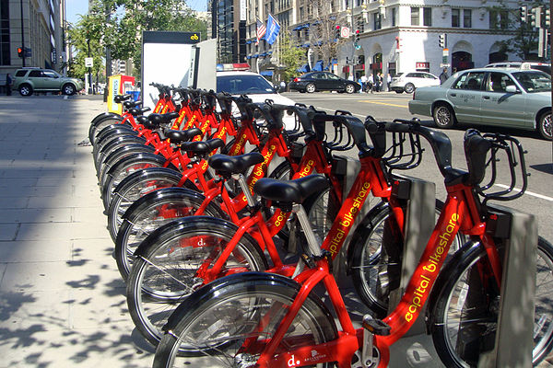


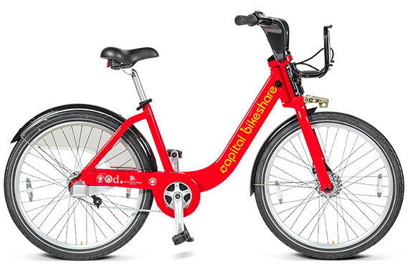
BACKGROUND:
Founded in 2010
600+ Station
Bike share business model
Among the top 3 Bike Sharing system in USA
5000+ Bikes
Washington D.C

Slide 3



PROBLEM STATEMENT:
To predict the highly fluctuating bike share rental demand based on the given Data
Data
Date
User Membership details
Humidity
Precipitation accumulation
Windspeed
Precipitation
Time
Dewpoint
Season
Weekend/Weekday
Temperature
Pressure
Weather
Wind gust

Slide 4
ASSUMPTION:
The variation in dependent variable can be explained by linear/curvilinear, additive relationship between dependent variable and a set of k independent variables
The relationship between independent variable and dependent variable is either linear or curvilinear
The independent variables do not influence other independent variables
The prediction errors follow a normal distribution with mean zero and constant variance

Slide 5
MODEL:
Exploratory Data Analysis
Feature Engineering
Data preparation
Correlation analysis
Data
Data cleaning
Demand prediction
One hot encoding
Regression
Descriptive statistics
Polynomial feature transformation

Slide 6
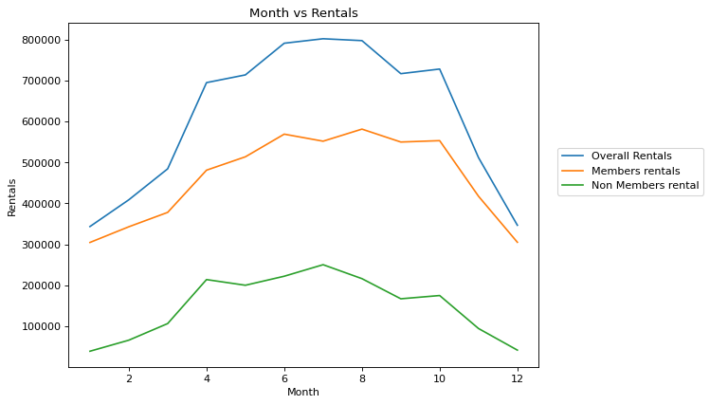
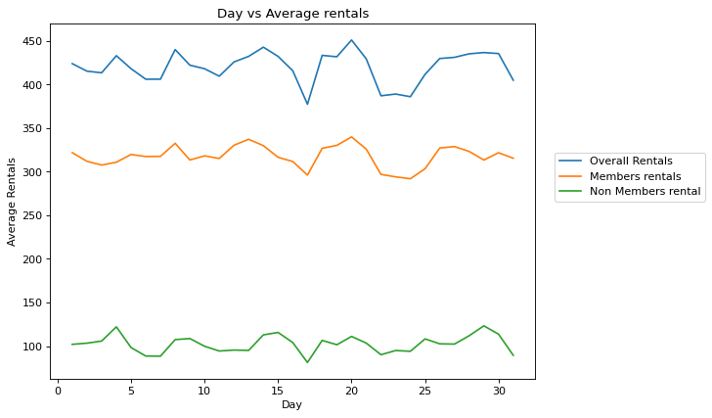
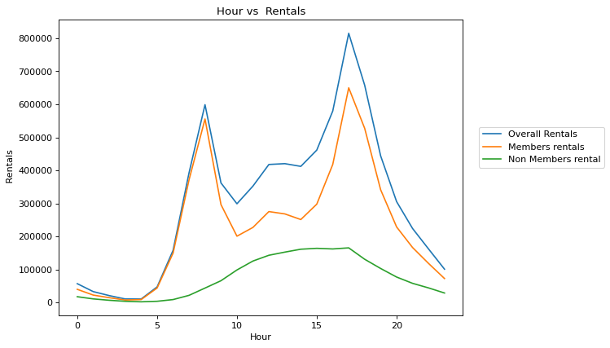
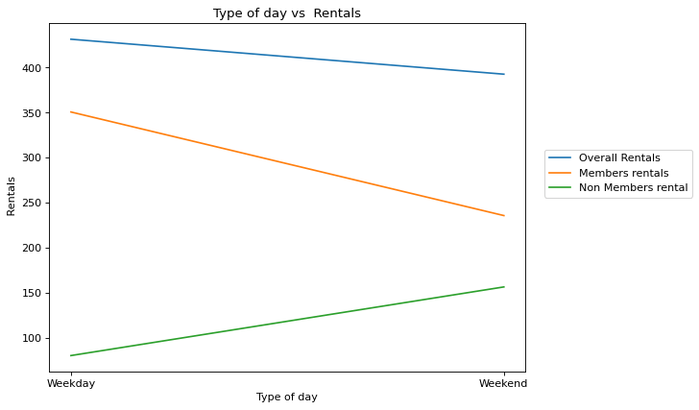
EXPLORATORY DATA ANALYSIS:

Slide 7
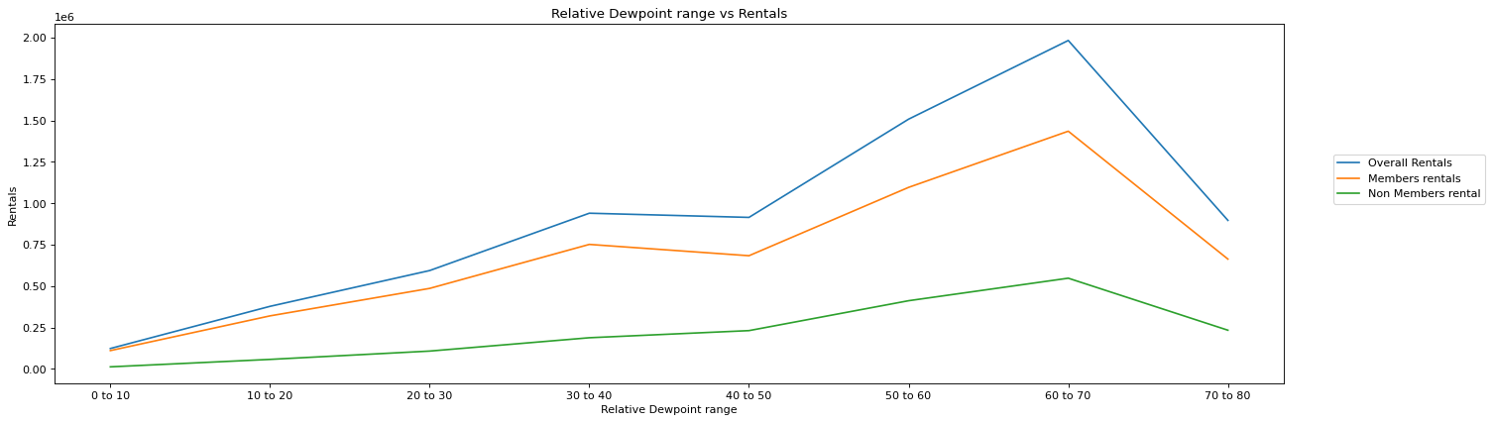
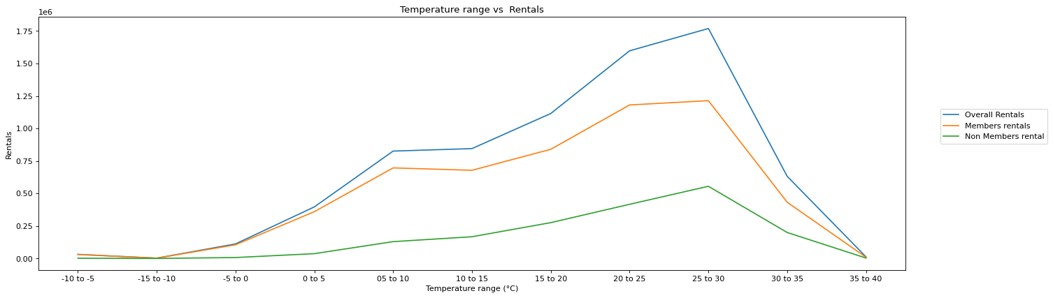
EXPLORATORY DATA ANALYSIS:

Slide 8
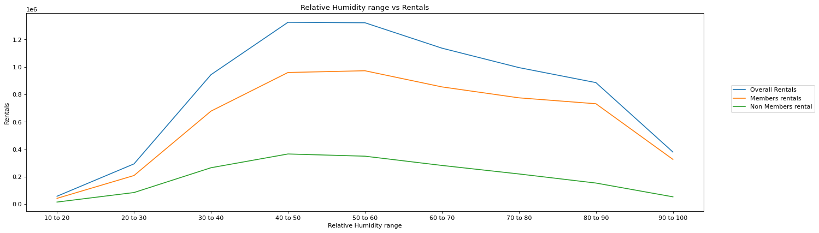
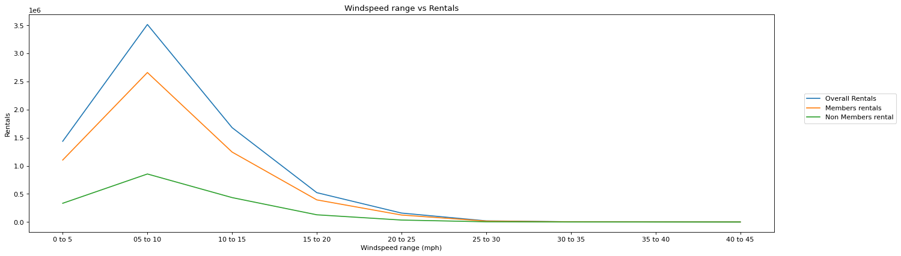
EXPLORATORY DATA ANALYSIS:

Slide 9
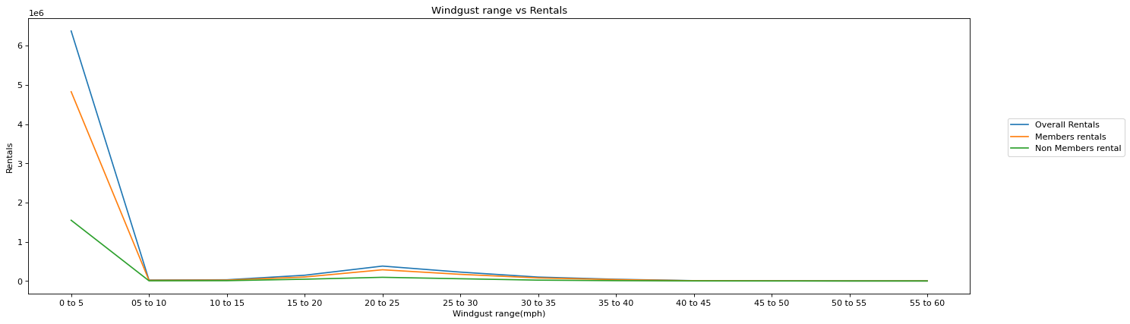
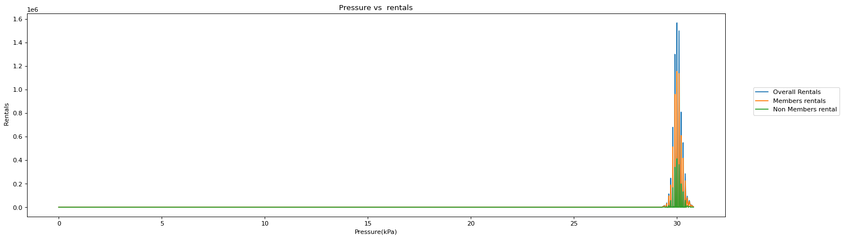
EXPLORATORY DATA ANALYSIS:

Slide 10
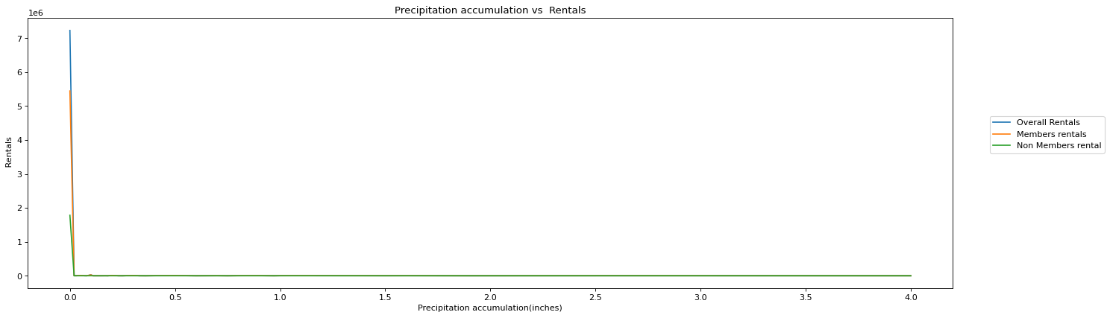
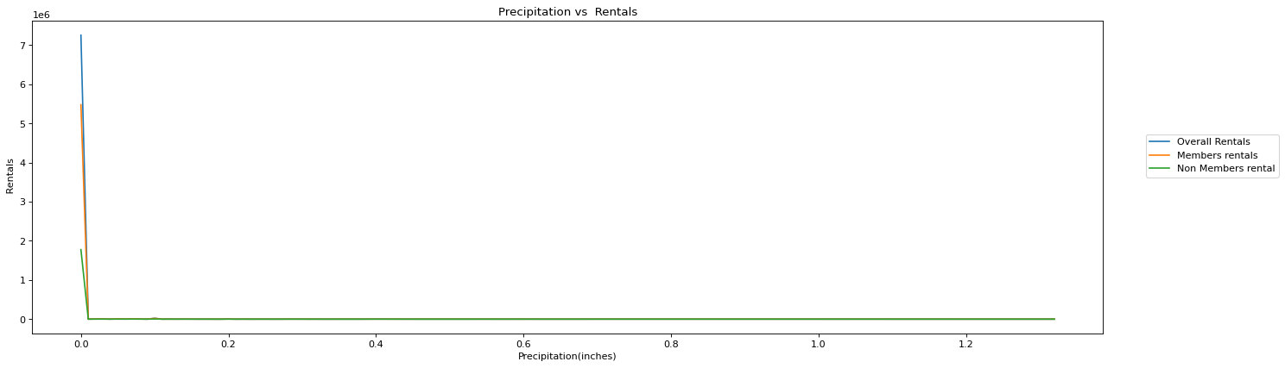
EXPLORATORY DATA ANALYSIS:

Slide 11
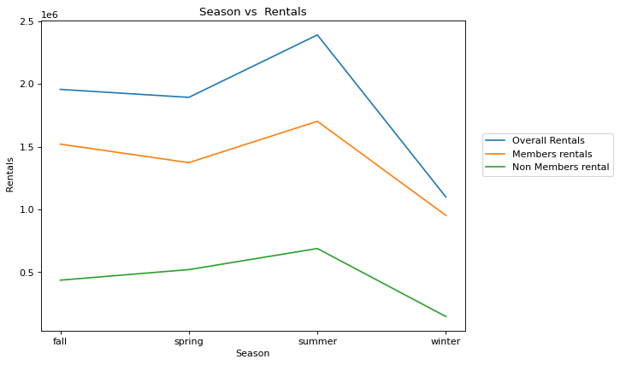
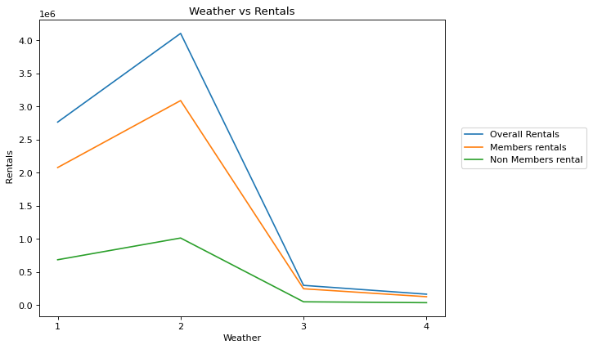
EXPLORATORY DATA ANALYSIS:

Slide 12
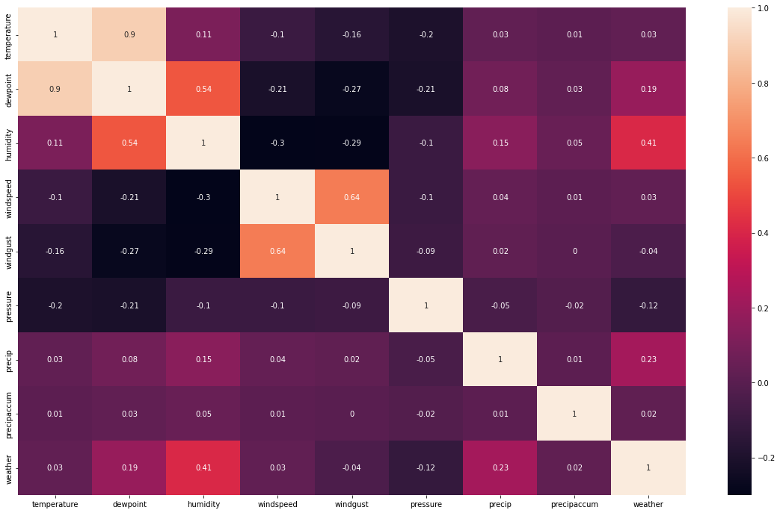
FEATURE ENGINEERING:
Correlation matrix

Slide 13

FEATURE ENGINEERING:
One Hot Encoding
Categorical variables
Dummy variables
Month
Hour
Season
Weather
Feature Selection
Humidity
Precipitation accumulation
Hour
Day
Windspeed
Precipitation
Month
Year
Dewpoint
Season
User Membership details
Temperature
Pressure
Weekend/Weekday
Weather
Wind gust

Slide 14
FEATURE ENGINEERING:
Polynomial feature transformation:
Since the relationship between the independent and dependent variables is not exactly linear, polynomial feature transformation is used to improve the model accuracy

Slide 15
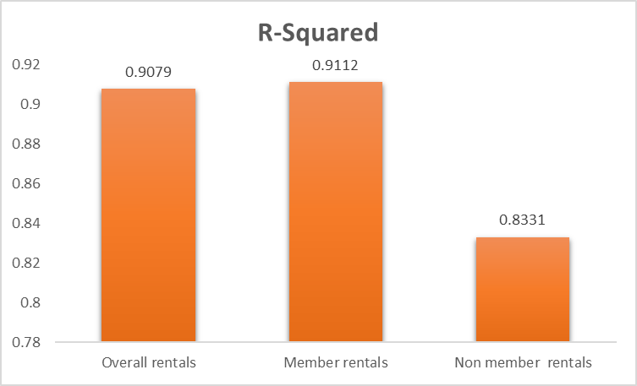
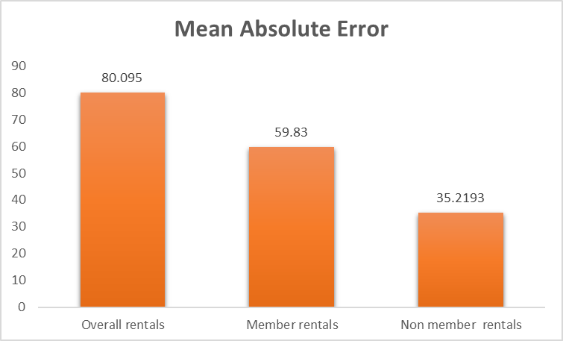
RESULT

Slide 16
RECOMMENDATIONS
Recommendation 1:
Establish separate model training and predicting procedures for registered users and non-registered users .This will result in better accuracy since consumer behavior is not uniform across both the categories. Demand from registered users is high during weekday whereas demand from non registered users is high during weekend
Recommendation 2:
Maintain high safety stock for to support predictions made for non-registered users when compared to that of registered users. This will result in better management of less accurate predictions of non-registered users.
Recommendation 3:
Release promotional offers to increase demand from registered users during weekends. Since registered users occupy a major share in the customer base, this move will result in significant revenue rise.
Recommendation 4:
Increase research initiatives to study the consumer behavior of non-registered users since predicting their demand from the existing independent variables results in relatively low accuracy.

